Slide 1
Themes
Themes
Facets
Facets
Coordinates
Coordinates
Scales
Scales
Statistics
Statistics
Geometries
Geometries
Mapping
Mapping
Data
Data

Slide 2
Themes
Themes
Facets
Facets
Coordinates
Coordinates
Scales
Scales
Statistics
Statistics
Geometries
Geometries
Mapping
Mapping
Data
Data

Slide 3
Themes
Themes
Facets
Facets
Coordinates
Coordinates
Scales
Scales
Statistics
Statistics
Geometries
Geometries
Mapping
Mapping
Data
Data

Slide 4
Themes
Themes
Facets
Facets
Coordinates
Coordinates
Scales
Scales
Statistics
Statistics
Geometries
Geometries
Mapping
Mapping
Data
Data

Slide 5
Themes
Themes
Facets
Facets
Coordinates
Coordinates
Scales
Scales
Statistics
Statistics
Geometries
Geometries
Mapping
Mapping
Data
Data

Slide 6
Themes
Themes
Facets
Facets
Coordinates
Coordinates
Scales
Scales
Statistics
Statistics
Geometries
Geometries
Mapping
Mapping
Data
Data

Slide 7
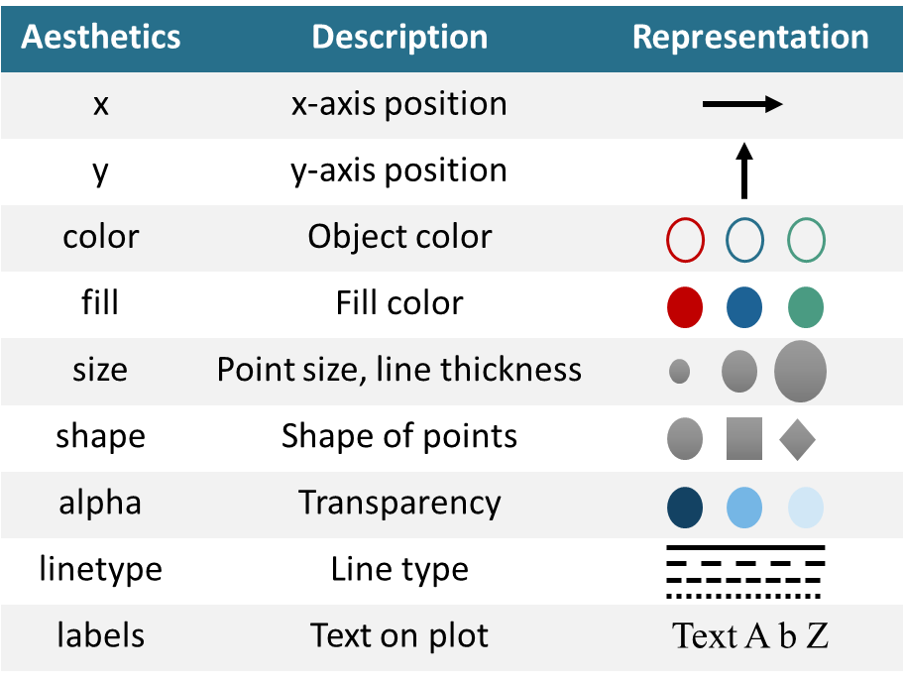
Aesthetics | Description | Representation
x | x-axis position
y | y-axis position
color | Object color
fill | Fill color
size | Point size, line thickness
shape | Shape of points
alpha | Transparency
linetype | Line type
labels | Text on plot | Text A b Z

Slide 8
Geoms | Default stat | Aesthetics
line | identity | color, linetype, size, x, y
linerange | identity | color, linetype, size, x, ymax, ymin
path | identity | color, linetype, size, x, y
point | identity | color, fill, shape, size, x, y
pointrange | identity | color, fill, linetype, shape, size, x, y, ymax, ymin
polygon | identity | color, fill, linetype, size, x, y
quantile | quantile | color, linetype, size, weight, x, y
rect | identity | color, fill, linetype, size, xmax, xmin, ymax, ymin
ribbon | identity | color, fill, linetype, size, x, ymax, ymin
rug | identity | color, linetype, size,
segment | identity | color, linetype, size, x, xend, y, yend
smooth | smooth | alpha, color, fill, linetype, size, weight, x, y
step | identity | color, linetype, size, x, y
text | identity | angle, color, hjust, label, size, vjust, x, y
tile | identity | color, fill, linetype, size, x, y
vline | vline | color, linetype, size

Slide 9
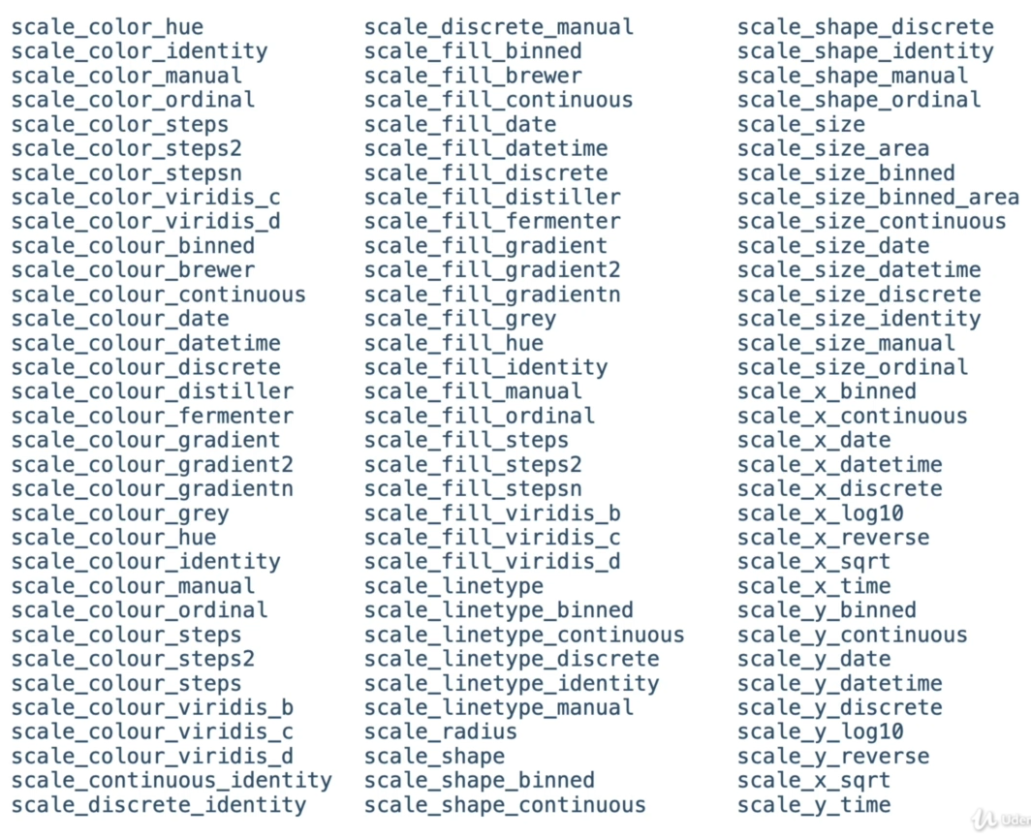


Slide 10
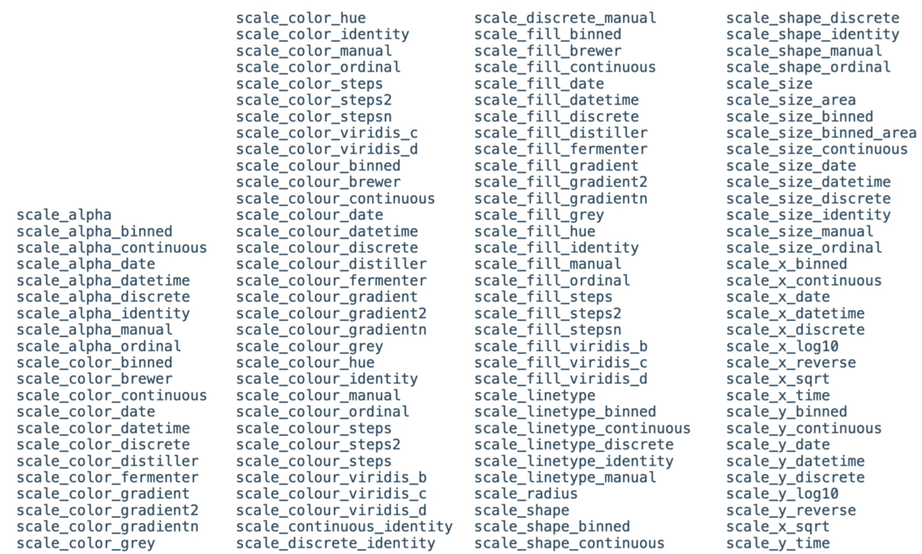

Slide 11
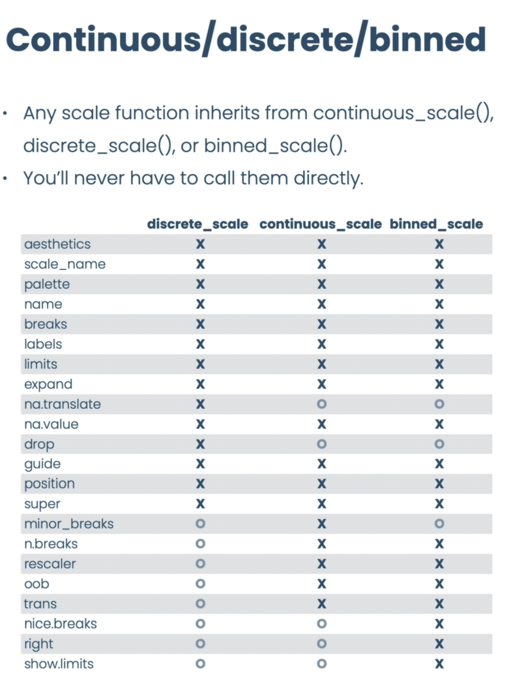
parameter | discrete_scale | continuous_scale | binned_scale
name | ✓ | ✓ | ✓
breaks | ✓ | ✓ | ✓
labels | ✓ | ✓ | ✓
limits | ✓ | ✓ | ✓
expand | ✓ | ✓ | ✓
na.value | ✓ | ✓ | ✓
drop | ✓ | x | x
guide | ✓ | ✓ | ✓
position | ✓ | ✓ | ✓
minor_breaks | x | ✓ | x
n.breaks | x | ✓ | ✓
oob | x | ✓ | ✓
trans | x | ✓ | ✓

Slide 12
Dataset
Mapping from variable to aesthetics
Layers
Geometries
Statistical transformation
Position adjustment

Slide 13




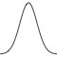
geom_area( )
geom_bar( )
geom_dotplot( )
geom_histogram( )
geom_density( )

